Slide 1
MIST7590 Team Meeting
Next Deliverables
User Requirements/Security Remediation Plan
System Requirements
WBS/Project Plan
Incremental Development Approach
Challenges, Data with Logical Models
Technical Presentation
Due date TBD

Slide 2
Friends of Smithgall Woods
Mission Statement
To promote the goals of Smithgall Woods – Dukes Creek Conservation Center Area and to support the educational and interpretive activities, facilities, and resource management, maintenance, and improvement activities of the division in these sites

Slide 3
Dr. Huber’s Recommendation
This project will be more of a rebuild and enhance than a reinvent the wheel
However, the analysis and your team’s recommendations will also be a major deliverable for Fall
Look at the existing website and extract what you think are the initial requirements of the Friends Chapter
This will also give you an idea of the feature set and UI/UX
Biggest complaints about the website were ease of update/maintenance, and security
Use the feature set you discover to create a starting point for the conversation with the sponsor.

Slide 4
User Requirements / Security Remediation Plan
Ensure website is free of any malicious injected codes
Determine which website contents can be reused
Determine which database tables should be retained or rebuilt
Recommend adding necessary functionalities such as report generator of volunteer hours, state site link, etc.
Recommend redesigning site for optimized UX/UI

Slide 5
User Requirements
Gather potential user requirements from team members
Website Pages (Home, About Us, Activities, Volunteer Opportunities, Contact Us, and Friends Chapter)
Become a Friend or Volunteer Page
Cottage Accommodations Page
Volunteer Hours Log Page with Mobile Capability
Volunteer Report Generator Page with Separate Login
Example of User Requirement
Smithgall Woods application shall generate volunteer reports showing the number of volunteer hours
Due by Monday, Sep 18th

Slide 6
System Requirements
Define system requirements using detailed descriptions of website’s functionalities, services and operational constraints
Use necessary technical descriptions
Example of System Requirement
This application shall generate volunteer reports by type of volunteer work, specific time period, and number of hours
Due by Sunday, Sep 24th

Slide 7
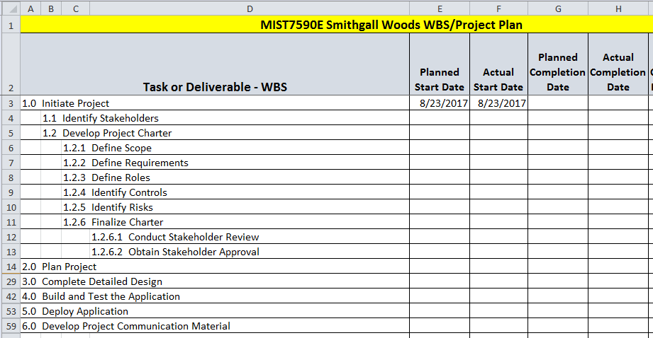
WBS/Project Plan
Update Project Plan by Sep 30th

Slide 8
Development Approach
Use Incremental Approach
Learn using WordPress & PHP
Use single type IDE/Code Editor (Eclipse)
Use Java and JavaScript Libraries
Simplify rebuild of the website
Avoid reinventing the wheel
Build a simple prototype of the website

Slide 9
Challenges
Start making notes of challenges you come across
Briefly describe applied solution

Slide 10
BACKUPS

Slide 11
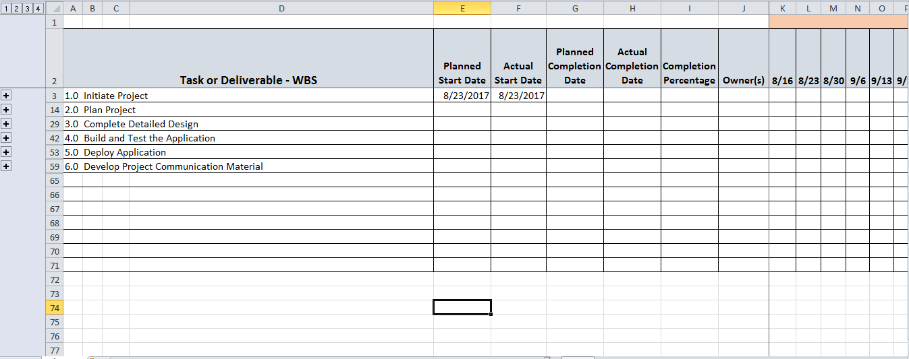
WBS / Project Plan

Slide 12
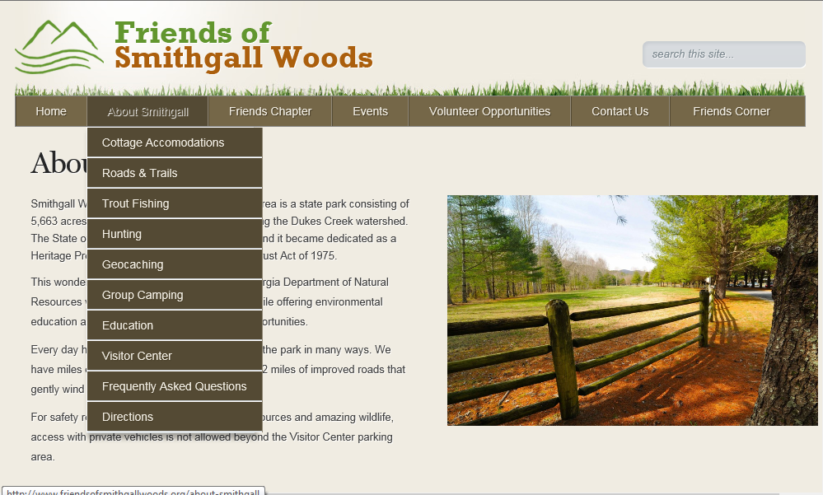
Site Pages

Slide 13
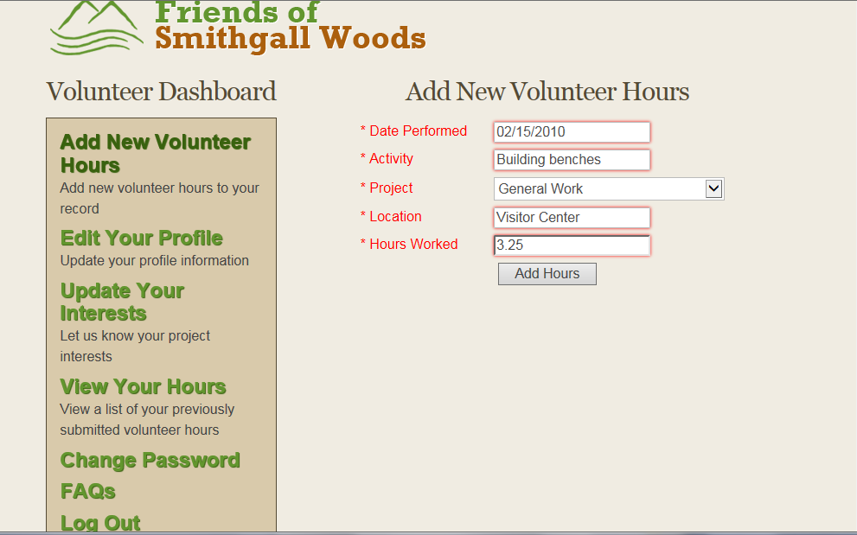
Volunteer Hours Log Page

